Slide 1



Wallonia
Business and Competitiveness Clusters
MAGEOSZ and the Wallonia Foreign Trade and Investment Agency
Opportunities of Cooperation

Slide 2
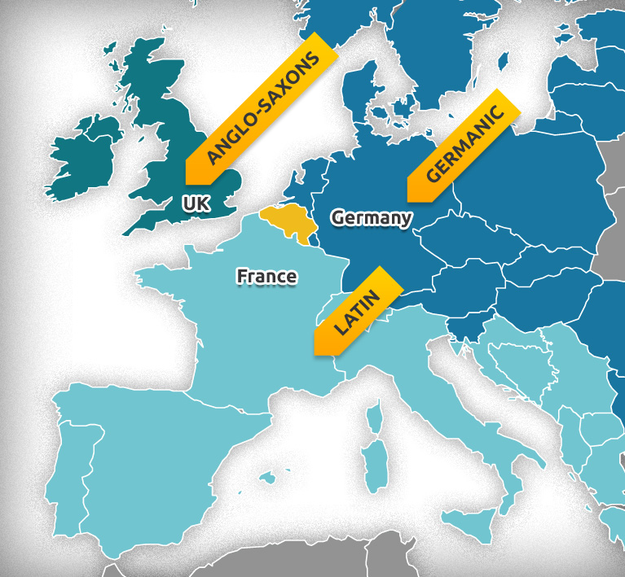
BELGIUM
At the border of 3 main European cultures
11 million inhabitants
Official languages: French, Dutch, German
Independent since 1830
Federal state since 1993
Head of state: King Philippe since 2013
Capital: Brussels

Slide 3
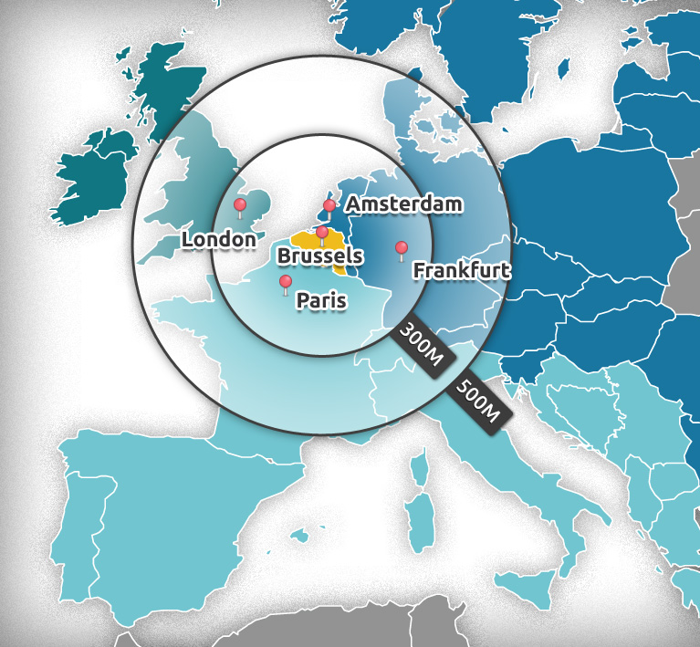
Connections to Europe
75 %
of the EU
market (GDP)
40 %
of the
consumers

Slide 4
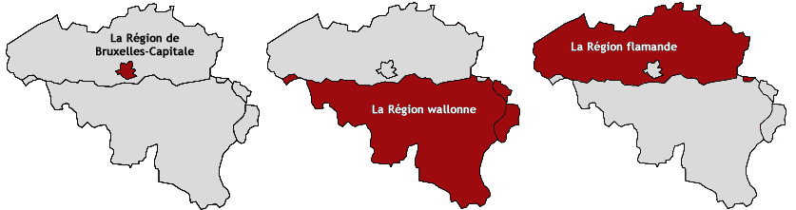
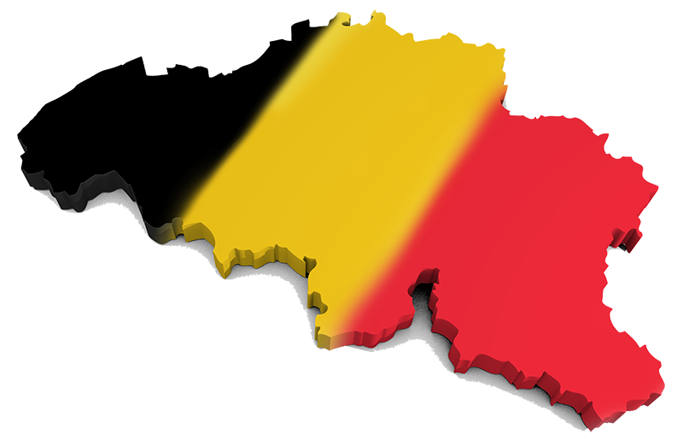
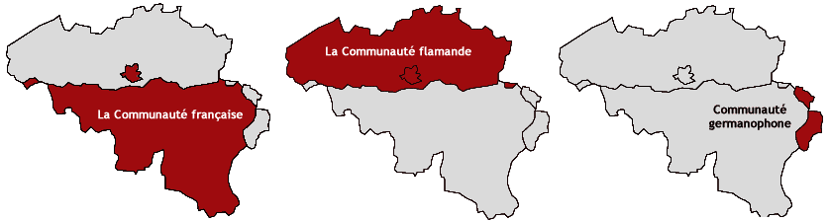
Belgian Political Organization

Slide 5
Federal competencies
Internal security and justice
Social security, employment law
Main legal codes (civil, criminal, commercial)
Defence
Monetary and credit policy
Food chain security
Nuclear and space policy
Foreign affairs (in collaboration with federated entities)

Slide 6
Regional competencies
Housing and regional development
Environment and agriculture (+ energy and water)
Public works and transport
Economic policy, foreign trade, foreign investment and employment
Health and social assistance
Supervision of local and provincial governments
Scientific research and new technologies
External relations in all these areas

Slide 7
Community competencies
Language
Culture
The audiovisual sector
Education
Care

Slide 8
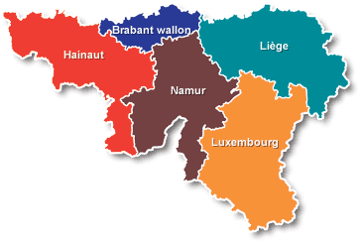
WALLONIA
Territory: 16,844.3 km² (55,2% of Belgian territory)
Population: 3,589 million inhabitants
5 provinces: Hainaut, Walloon Brabant, Namur, Liège, Luxembourg
20 administrative arrondissements
262 communes

Slide 9
Economy
Wallonia is 0.10% of world GDP BUT Walloon businesses provide 0.30% of global trade
GDP: 87,9 bn €
GDP growth rate in volume: 1,3%
Average annual growth in international export of goods and services: 3,8%
1 161 000 Walloons active in the Walloon labour market
70 000 businesses – 650 000 jobs
9 employees on average per company
2 000 new businesses per year
8 000 businesses export with AWEX

Slide 10
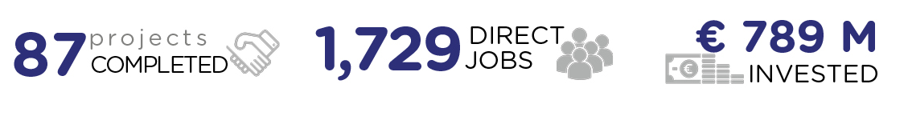
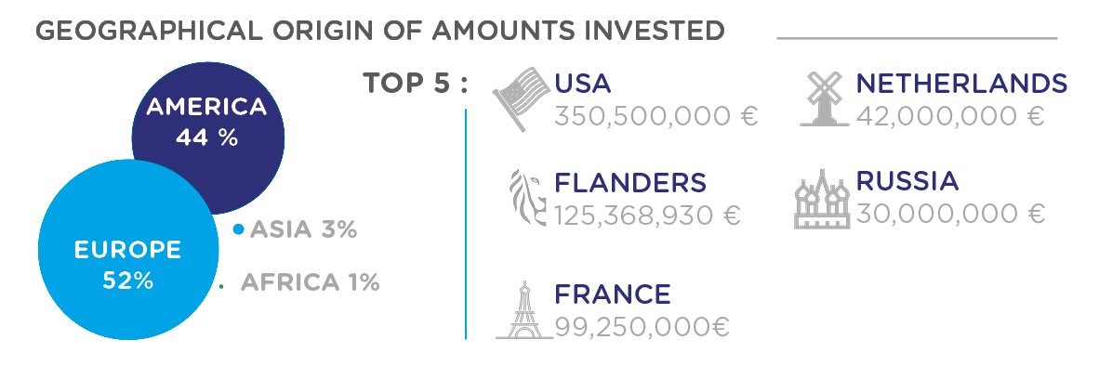
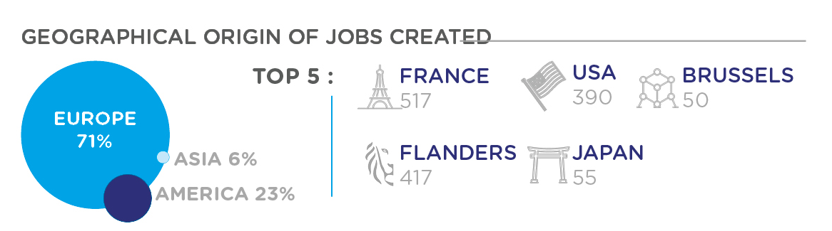
Foreign investments in Wallonia

Slide 11

The aura

Slide 12




Wallonia’s “power of ten”
ACCESSIBILITY
its presence at the heart of Europe
its location which gives access to the markets
the quality of its real estate offering
TECHNICAL KNOW-HOW
innovative Wallonia
labour and productivity
SENSE OF SHARING
financial incentives
access to capital
QUALITY OF LIFE
export
living in Wallonia
leisure

Slide 13
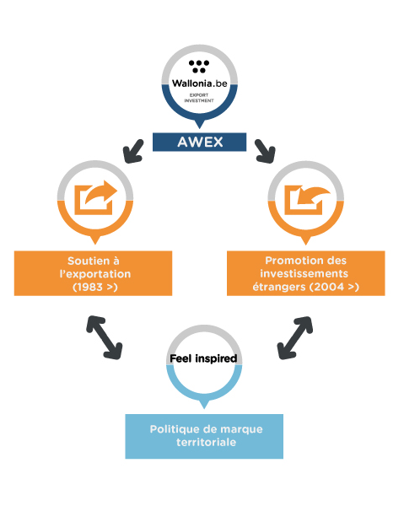
AWEX
since 1983
in Budapest since 1995 (Wallonia – Brussels)
since 2011: AWEX - Brussels Invest & Export
about 450 employees, more than 100 abroad
budget: 80 million €
Public service organisation "B"

Slide 14
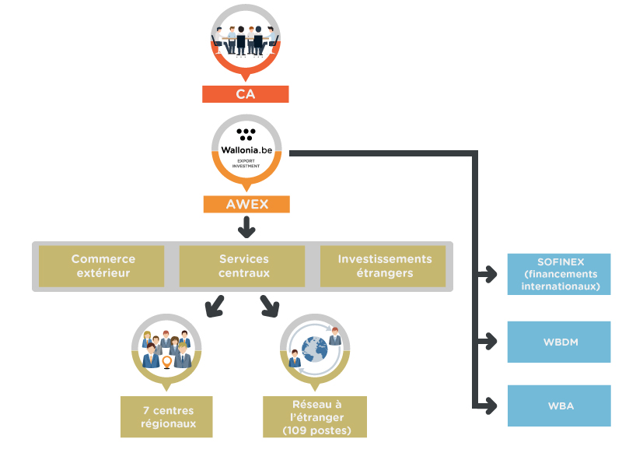
Structure

Slide 15
Regional Centres
Charleroi
Libramont
Liège
Eupen
Mons
Namur
Nivelles

Slide 16
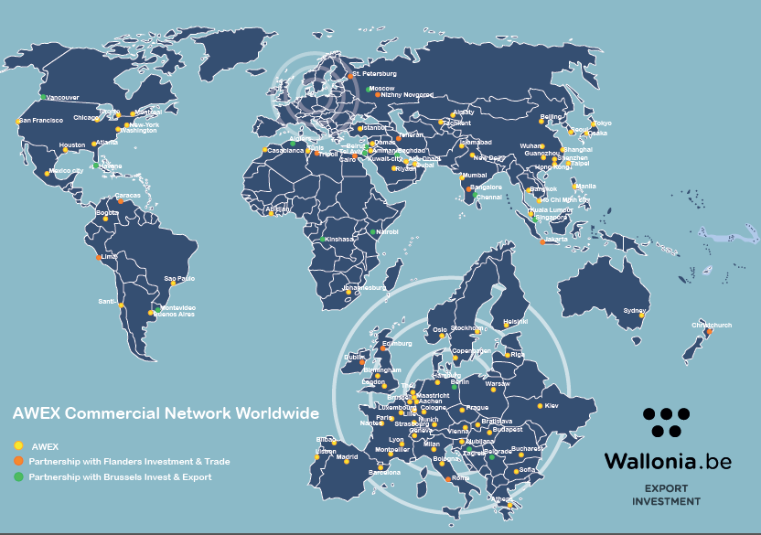
Global Network
Economic and Trade Counsellors

Slide 17
Role of Economic and Commercial Counsellors
    Representation of Wallonia
    General and individual market information
    Trade promotion and development
    Dissemination of business opportunities
    Trade assistance
    Support with identifying potential investors

Slide 18
Objectives
Increase Wallonia's international visibility and attractiveness (regional branding policy)
Improve companies' professionalism with regard to exports
Contribute to annual growth of Walloon exports above that of competing European regions
Diversify the geographical approach to exports
Strengthen the sectoral approach
Ensure a quality after-sales service

Slide 19
Key Sectors
Agrifood
Aeronautics and Space
Engineering and new materials
Transport and Logistics
Life sciences
Environmental technologies

Slide 20








Business Clusters
Environment and Sustainable Development
Transversal Technologies

Slide 21






Competitiveness Clusters
Mobility and Transport
Environment and Sustainable Development
Food – Health
Transversal Technologies

Slide 22

Transversal Technologies: mechanical engineering
270 industrial and academic entities
provides functional systems
relies on a diverse base of scientific and technological knowledge and know-how

Slide 23
Four strategic lines of development:
        Materials and surfaces of the future
        Comprehensive forming technologies
        Micro technologies and mechatronics engineering
        Intelligent production and maintenance

Slide 24
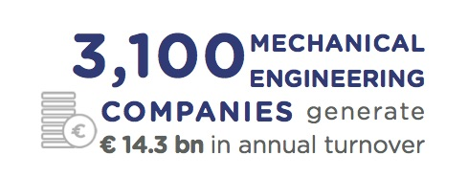

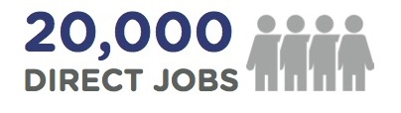




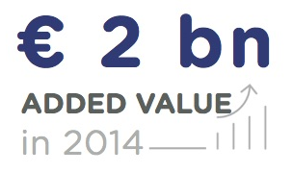

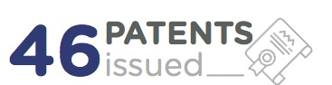
Wallonia in figures

Slide 25
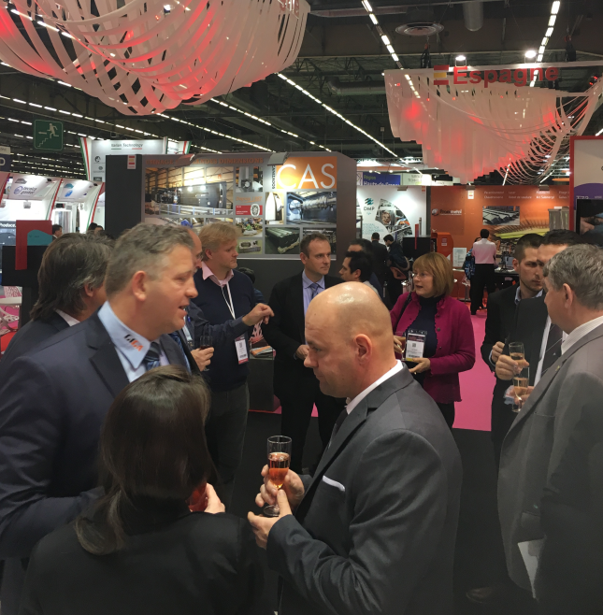
Pilot Project at Midest
Global show for all industrial subcontracting know-how
Paris Nord Villepinte
Pilot project created by the Hungarian National Trade House and the AWEX:
    B2B Wallonia-Hungary organized between Hungarian and Walloon companies
This cooperation will go on in 2017 !

Slide 26


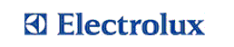












































They have already chosen Wallonia…

Slide 27

FEEL INSPIRED
For further information
Wallonia Export & Investment Agency
Office For Foreign Investors
www.investinwallonia.be - welcome@investinwallonia.be
www.wallonia.hu

Slide 28
Tanguy HUYBRECHS
Mechanical Engineering & Advanced Materials Expert
(T) +32 81 33 28 77
thuybrechs@investinwallonia.be
www.investinwallonia.be
www.awex.be
Jacques GERMAY
Managing Director
(T) +32 81 20 68 50
jacques.germay@polemecatech.be
info@polemecatech.be
www.polemecatech.be

Slide 29
RÁNKY EDIT
Economic and Trade Counsellor
EMBASSY OF BELGIUM
ECONOMIC AND COMMERCIAL REPRESENTATION OF WALLONIA AND THE BRUSSELS-CAPITAL REGION
1051 Budapest, Bajcsy-Zsilinszky út 12. #608
Tel: (+36 1) 266 8621
Fax: (+36 1) 266 8622
budapest@awex-wallonia.com
www.awexbudapest.hu

